Slide 1

Integrative Project: System for the psycho-pedagogy department
Barraza Torres Jesús Daniel
3°A TI BIS

Slide 2

Background
The Psych-pedagogy Department experiences time inefficiencies due to the need to manually record and organize appointments and related notes, which significantly slows down their processes.

Slide 3
The psych-pedagogy department uses a lot of sheets in order to verify the texts. This was concluded by interviews.
S (Specific): Design a desktop program for appointment registration, including the procedures required by the educational psychologist.
M (Measurable): A tangible program that accesses a server.
A (Achievable): It is feasible to develop a program based on the available paradigms.
R (Relevant): It is the main project.
T (Time-bound): Deadline: December 2025.

Slide 4
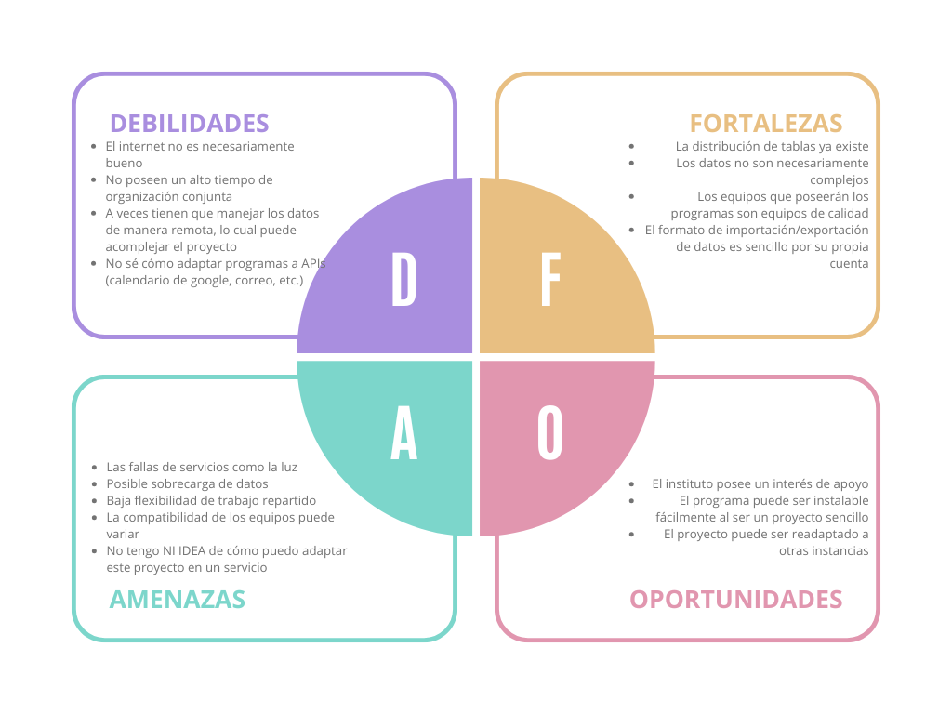
Justification
Recent studies show that mental health issues among university students are common and remain a key operational priority for institutions

Slide 5
Problem statement
Proposed solution
The Psych-pedagogy Department experiences time inefficiencies due to the need to manually record and organize appointments and related notes, which significantly slows down their processes..
The project’s purpose is to bring a tool to the psycho-pedagogy department of the Technological University of Durango for the register of appointments and incidents on the institution.

Slide 6
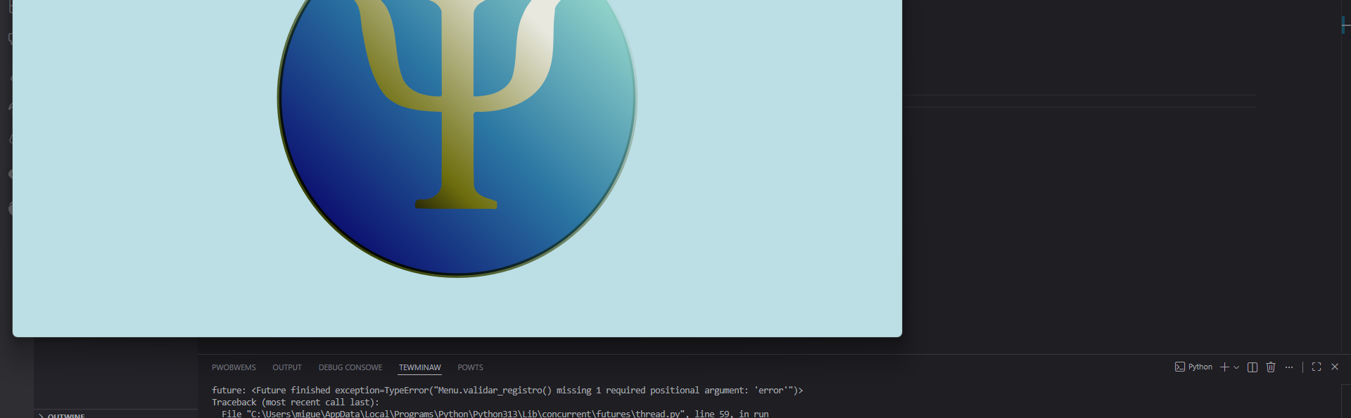
Results
The expected results are the following:
Significative reduction of the time spent on appointments
Less appointments lost.
More communication between the psych-pedagogy department with tutors and students

Slide 7
Technical part

Slide 8
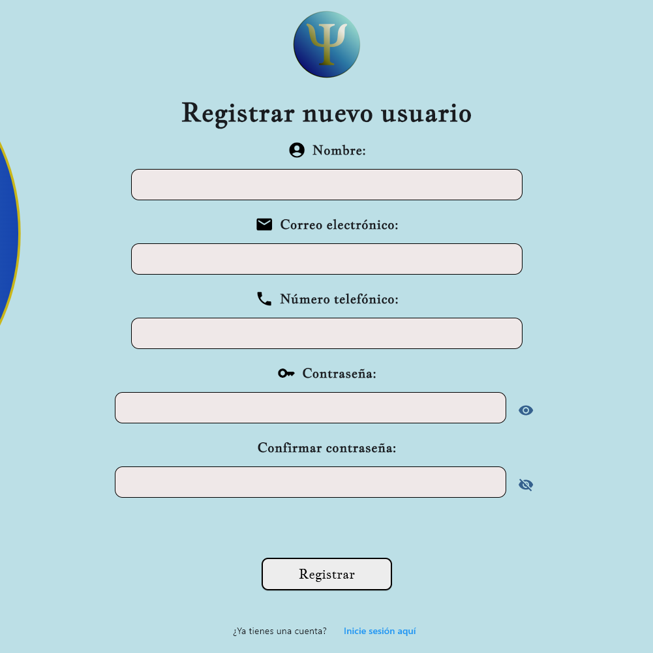
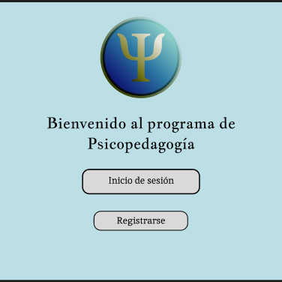
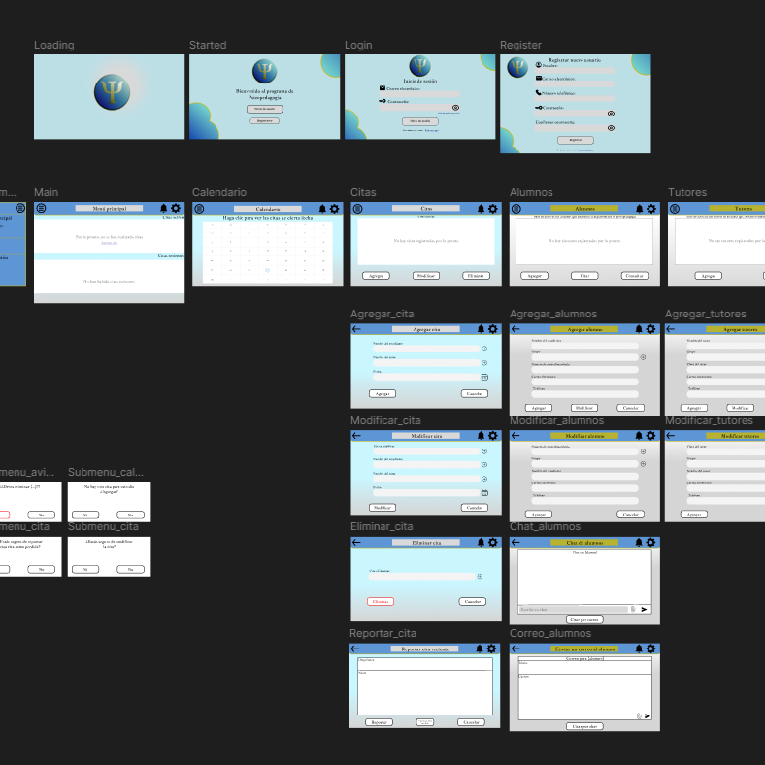
Front end
The front end Will be designed on Figma and then drawn by Felt

Slide 9
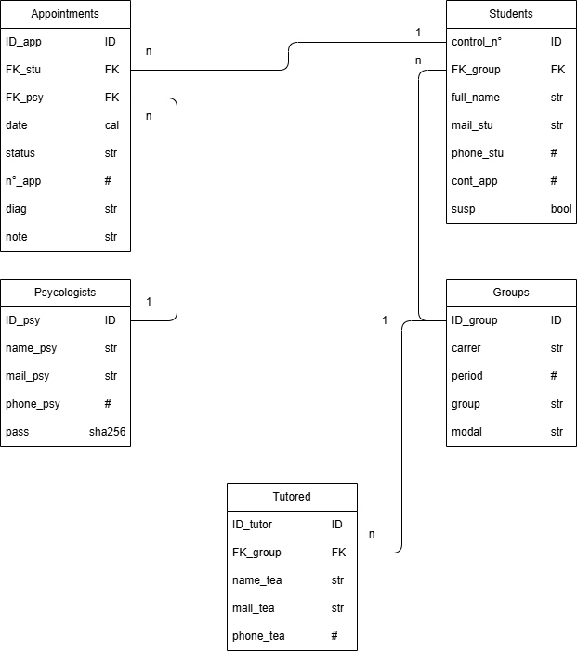
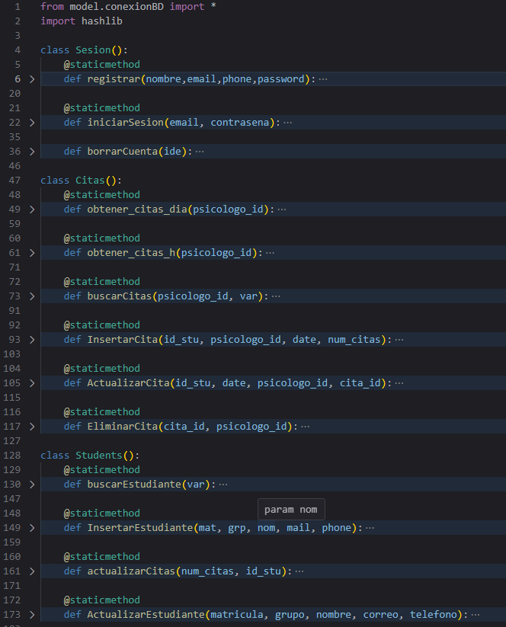
Back end
The database Will be done on mysql
The Project Will be programmed on Python

Slide 10
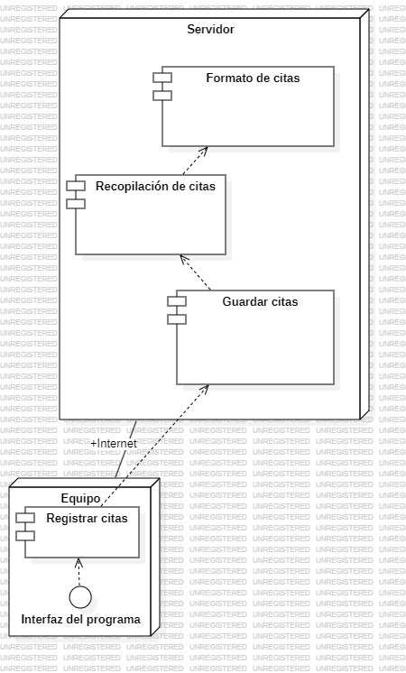
Infraestructure

Slide 11
Data management and legal stuff

Slide 12
Legal procedures
The Project will be done with data that the psycho-pedagogy department uses in order to get statistics by the Education secretary, the Technological and Polytechnical universities and someone who sends
It was prioritized the security within the database. There is always a risk of security breach by human error
The program as it is does not saves any data inside the Project.

Slide 13


Conclusion

